Slide 1
ABSTRACT FACTORY
Team 2
Nguyen Duc Khanh Thi
Bui Ngoc Thanh Mai
Nguyen Thanh Tung
Notes:
1

Slide 2
Introduction
Implement a game:
Enemies: Monster, Super monster, soldier.
2 levels : Easy / Hard
Dangerous of enemies depends on level

Slide 3
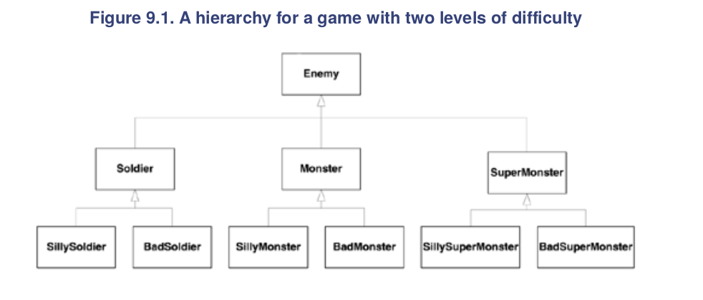
Solution

Slide 4
Drawbacks
2 levels do not run simultaneously.
BUT
When running Easy mode, must take care Hard mode too!
→ More easily to have problem with our game:
BadMonster might suddenly appear in Easy Mode!
Notes:
4

Slide 5

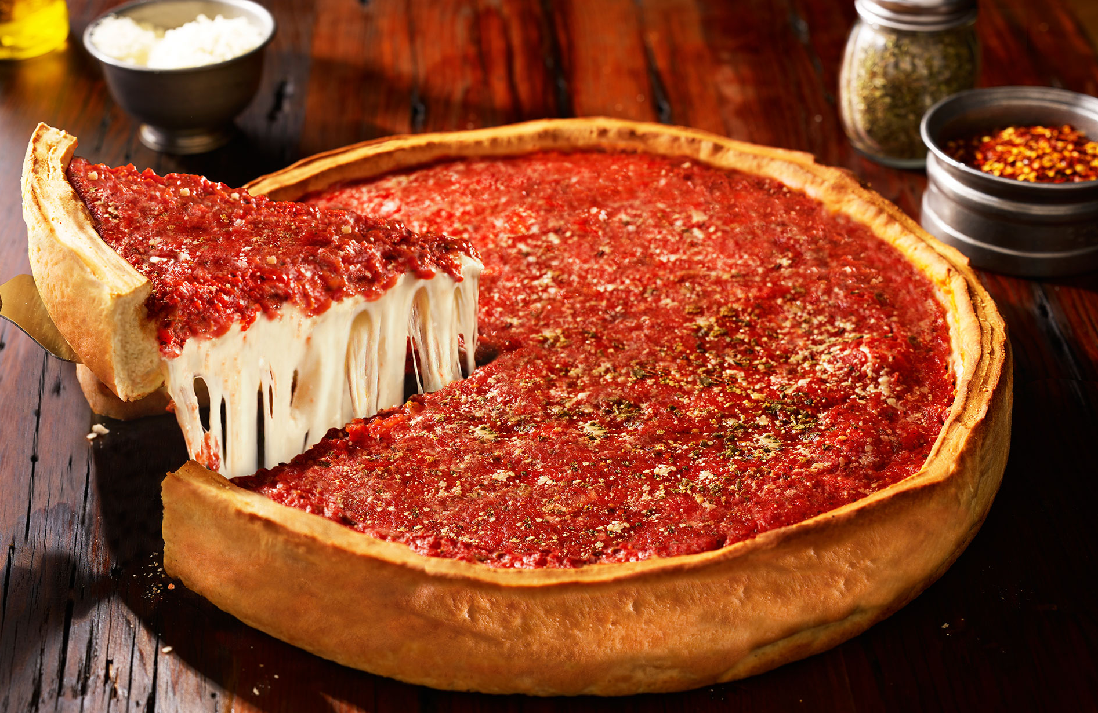

Problem
Suppose we have a Pizza factory.
We want to make variety kinds of pizza.
New york
Chicago
California
Notes:
5

Slide 6
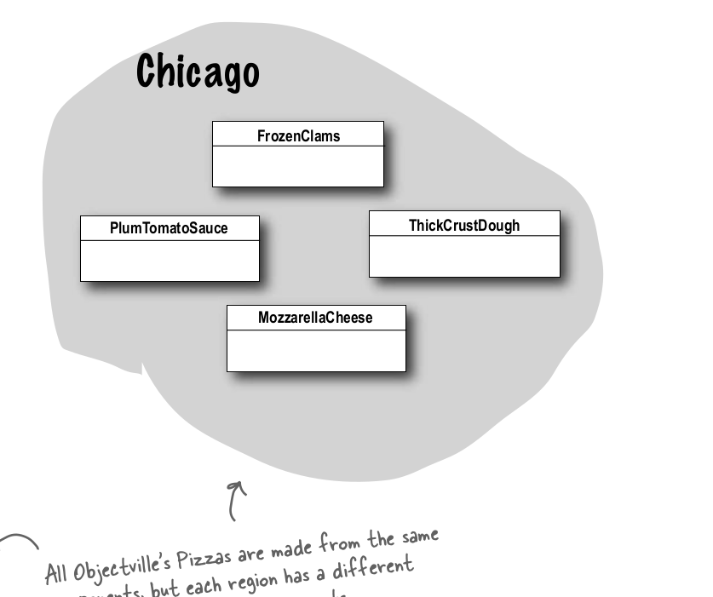
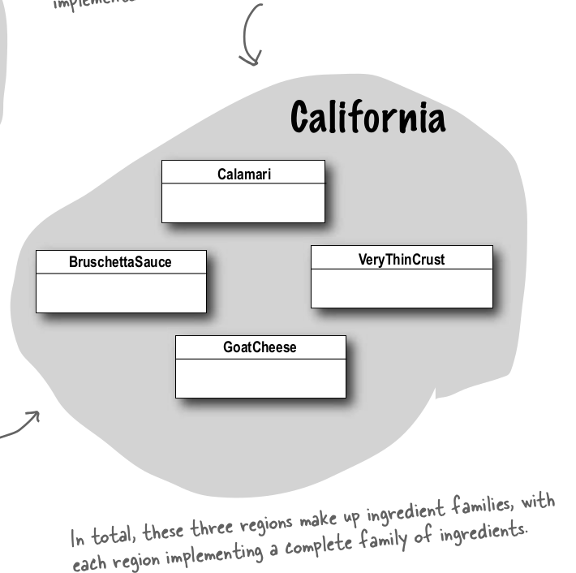
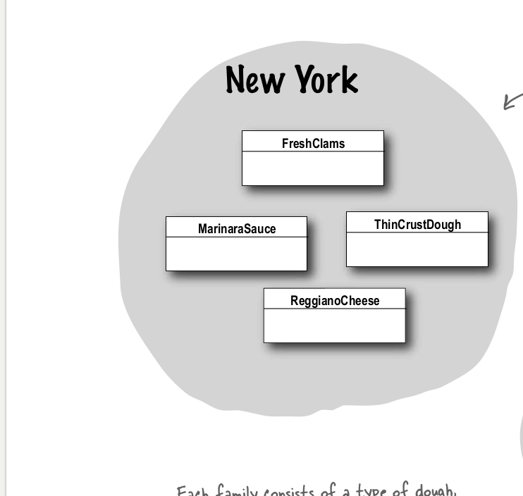
Solution
Create class for each kinds of pizza
Notes:
6

Slide 7
Drawbacks
Some similarities in method and ingredient (data) between different kinds of pizza.
BUT client have to implement many times for each kind of pizza when they only need the product.
-> NOT EFFICIENT
Notes:
7

Slide 8
DEFINITION
Abstract Factory patterns work around a super-factory which creates other factories (factory of factories).
This type of design pattern comes under creational pattern as this pattern provides one of the best ways to create an object

Slide 9
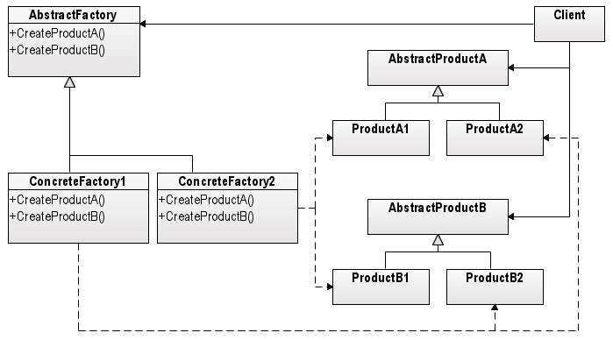
uses the interfaces declared by the AbstractFactory and AbstractProduct classes
declares a interface for operations that create abstract products
declares an interface for a type of product objects
implements operations to create concrete products

Slide 10
EXAMPLE PROBLEM
We need to create the appropriate object containing the information about pizza based on the user request of:
Type of pizza
Ingredient of that pizza
For the sake of simplicity, let's assume we have 3 types of pizza:
New York
Chicago
California
and there could be two ingredients for each pizza:
Cheese
Sauce

Slide 11
Creating the Abstract Products
//Cheese interface
class Cheese
{
public:
virtual std::string Name() = 0;
};
//Sauce interface
class Sauce
{
public:
virtual std::string Name() = 0;
};

Slide 12
Creating the Concrete Products
class MarinaraSauce : public Sauce
{
public:
std::string Name()
{
return " Marinara Sauce ";
}
};
class BruttchetaSauce : public Sauce
{
public:
std::string Name()
{
return " Bruttcheta Sauce ";
}
};
};
class ReggianoCheese : public Cheese
{
public:
std::string Name()
{
return " Reggiano Cheese ";
}
};
class GoatCheese : public Cheese
{
public:
std::string Name()
{
return “Goat Cheese";
}
};

Slide 13
Creating the Abstract Factory
//Header File
class PizzaFactory
{
public:
enum PIZZA_FACTORIES
{
NewYork,
Chicago,
California,
};
virtual Sauce* createSauce() = 0;
virtual Cheese* createCheese() = 0;
PizzaFactory* CreateFactory(PIZZA_FACTORIES factory);
};
//CPP File
PizzaFactory* PizzaFactory::CreateFactory(PIZZA_FACTORIES factory)
{
if(factory == PIZZA_FACTORIES::NewYork)
{
return new NewYorkFactory();
}
else if(factory == PIZZA_FACTORIES::Chicago)
{
return new ChicagoFactory();
}
else if(factory == PIZZA_FACTORIES::California)
{
return new CaliforniaFactory();
}
}

Slide 14
Creating the Concrete Factories
class NewYorkFactory : public PizzaFactory
{
public:
Sauce* createSauce()
{
return new MarinaraSauce();
}
Cheese* createCheese()
{
return new GoatCheese();
}
};
class ChicagoFactory : public PizzaFactory
{
public:
Sauce* createSauce()
{
return new MarinaraSauce();
}
Cheese* createCheese()
{
return new ReggianoCheese ();
}
};
class CaliforniaFactory : public PizzaFactory
{
public:
Sauce* createSauce()
{
return new BruttchetaSauce();
}
Cheese* createCheese()
{
return new GoatCheese();
}
};

Slide 15
Creating the Client
int main(int argc, char* argv[])
{
PizzaFactory* factory = PizzaFactory::CreateFactory(PizzaFactory::PIZZA_FACTORIES::NewYork);
cout << “New York’s pizza sauce : " << factory->createSauce()->Name() << "\n";
delete factory->createSauce(); //USe of smart pointer will get rid of these delete
cout << “New York’s pizza cheese: " << factory->createCheese()->Name() << "\n";
delete factory->createCheese(); //USe of smart pointer will get rid of these delete
delete factory;
getchar();
return 0;
}

Slide 16
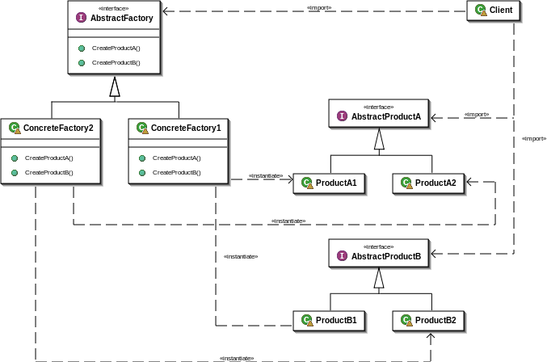
Advantages
Good way to organize the code (encapsulation)
Same factories can return variants of the same class
Families don’t have to be disjoint
Exchanging product families is easy
Promoting consistency among products (concrete’s factory job to make sure right products are used together

Slide 17
Disadvantages
Requires a new factory class for every product family
Families are defined statically
Require many changes when adding a new product:
New abstract product class added
New product implementation added
Abstract factory interface extended
Derived concrete factories must implement the extensions
Client has to be extended to use the new product

